Slide 1

Travel deeper.
At your own pace.
Contact us: asknavina.com | team@asknavina.com
Contact us: asknavina.com | team@asknavina.com

Slide 2
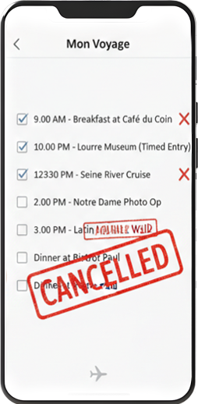

The Problem: Planning is static. Travel is dynamic.
STATIC PLAN
DYNAMIC REALITY
Travel rarely happens according to plan. Your mood changes. Conditions change. Opportunities appear.
Yet most travel tools keep telling you what's next, not what’s there for you now.
Result:
travelers over-plan, rush and
under-experience the places they visit.

Slide 3
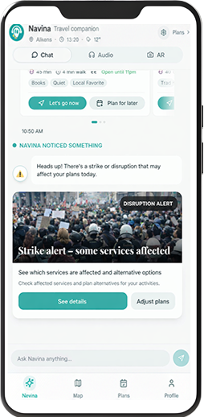

The Solution: Navina. Travel that adapts to you.
NAVINA ADAPTS
→ YOUR PACE
Adapts to your mood, time & energy.
→ RIGHT NOW
Adapt as conditions change.
→ GO LOCAL
Connects you with what fits you, local & trusted.
Not another itinerary.
A companion that travels with you.

Slide 4
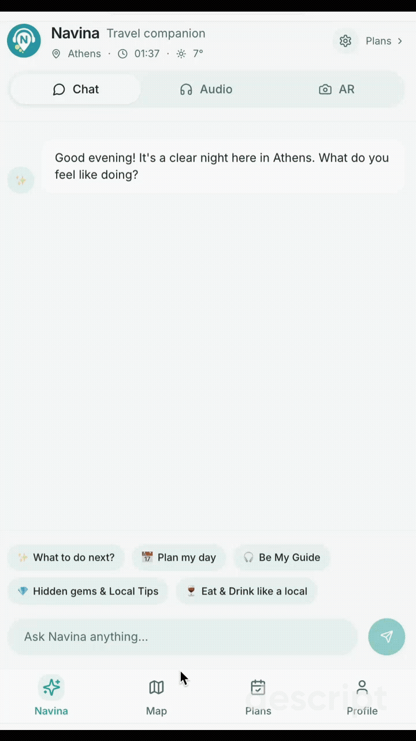
The Product: Navina AI Agent
UNDERSTANDS YOU
Mood · interests · location · pace
UNDERSTANDS NOW
Weather · events · disruptions · what's happening around you
GUIDES YOU
Personalized suggestions · local insights · proactive guidance

Slide 5
Business Model
A B2B2C-led model with complementary revenue streams
PRIMARY
Primary: B2B2C
Hotels · DMCs · Hosts
Co-branding license + per active user fee
Better guest experience · New revenue opportunities for partners
ADDITIONAL
B2C
Travelers
Passes + affiliate commissions
Freemium entry | Day/ Trip/ Mega Pass: €6.99–€34.99
10% on bookings (eg tickets, activities)
NEXT
B2G
DMOs · Tourism Boards
Destination partnerships & intelligence
Visitor Experience · Smart Discovery · Destination Insights

Slide 6
Global Market Opportunity - Large enough to build a global business.
700M international urban trips/ year
1
B2B2C: Partner Licenses
20–25K partners globally
245M relevant travelers
→ €40–60M/year
2
B2C: Services commissions
49M reachable
via hotels, DMC partners
€2 value per engaged user
→ €40M/year
3
B2C: Travel passes
20M engaged users
$57B
CAGR 8,5%
Direct consumer subscriptions
→ €8–12M/year
Global Opportunity for Navina
€90–110M annual revenue*
* only from the urban travelers’ segment

Slide 7
Starting with Athens - Our beachhead market and commercial proof.
8.8M international arrivals (Athens)
1
B2B2C: Partner Licenses
300 partners
→ €600K/year
2
B2C: Services commissions
€2 value per engaged user
→ €350K/year
3
B2C: Travel passes
Direct consumer subscriptions
→ €75K/year
Expected Annual Revenue
→ €1M from Athens

Slide 8











Competition
Personalized & Adaptive
Real-time. Personal. Local.
In-Destination Tools
AI Trip Planners
Planning &
Discovery
Reviews &
Social Discovery
In-Destination Companion
Generic &
Pre-planned

Slide 9
Our Competitive Advantage
Real-time
awareness
Hyper-personalized
experience
Proactive guidance
Curated local intelligence
Destination
Expertise
Mindful
by design

Slide 10
Go-to-Market & Growth Plan
Wider reach
Beachhead: Athens
Growth Loop
High density of experience-driven travelers.
Validate product-market fit, usage & partner economics.
Higher partner value
More usage
Distribution: B2B2C
Better local intelligence
Hotels, DMCs & hosts offer Navina to their guests.
Low-friction access via QR link - no app installation.
Better experience
Execution (18 months)
Scale: Destination by Destination
Phase 1
Phase 2
Core AI platform, add local content & partners, replicate across destinations.
Athens launch
GR + Int. launch

Slide 11







Built on 15+ Years of Destination Expertise
Since 2009:
Creating products for travelers
& destinations
Trusted by & partnered with:
2024
Greece's 1st CustomGPT
for Aegina island
Ask Navina is born
2025
Market research & Validation
CapsuleT accelerator
MVP pilot testing
B2B market interest
Today
Navina V2 Launching
B2B pilots planning
Finalist: Discover Lithuania 2026

Slide 12
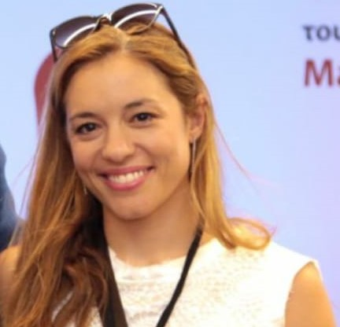
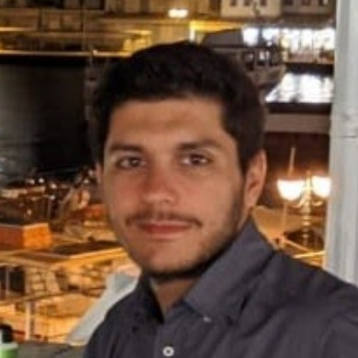
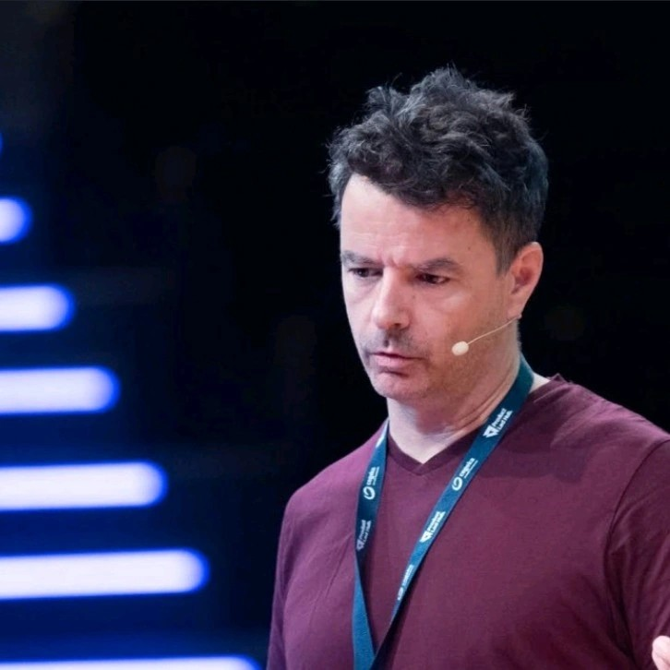
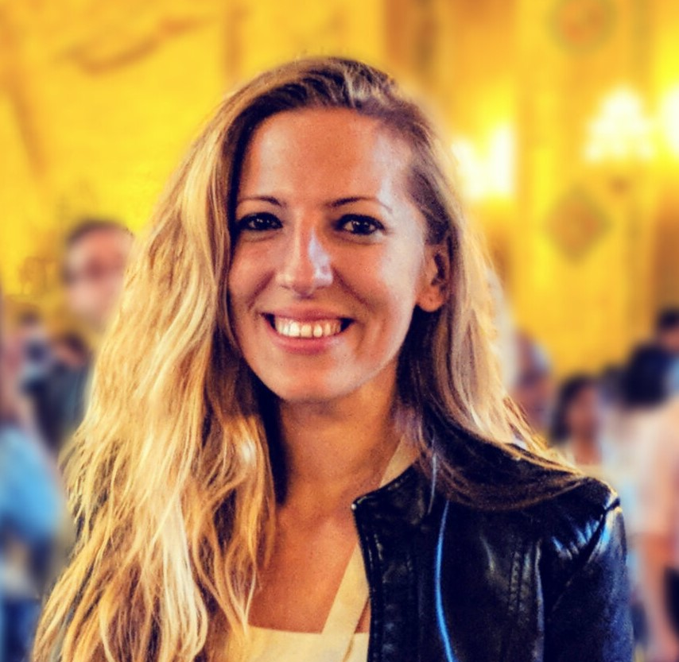

Team
Elina Argyri
Co-Founder
CBO
Antonis Legakis
Co-Founder
CTO
Michalis Rikakis
Founding Advisor
Product
Marily Nika, PhD
Founding Advisor
AI
Fokion Tasoulas
Advisor
Innovation
15+ years Destination Marketing
@We Destinate
Senior Full stack Software Engineer
EPAM & Natech
CEO @dikaio.ai,
ex-Google
ex-Workable
Gen AI Product @Google
ex-AI Product Lead @Meta
ex-Senior VP and Innovation Director @Titan

Slide 13
Ask
The Ask
€300K
Pre-Seed Funding
18 months runway to:
✓ Launch & validate V2
✓ Prove B2B2C model
✓ Prepare for international scale

Slide 14


Thank you!
app.asknavina.com
Contact us: asknavina.com | team@asknavina.com

