Slide 1
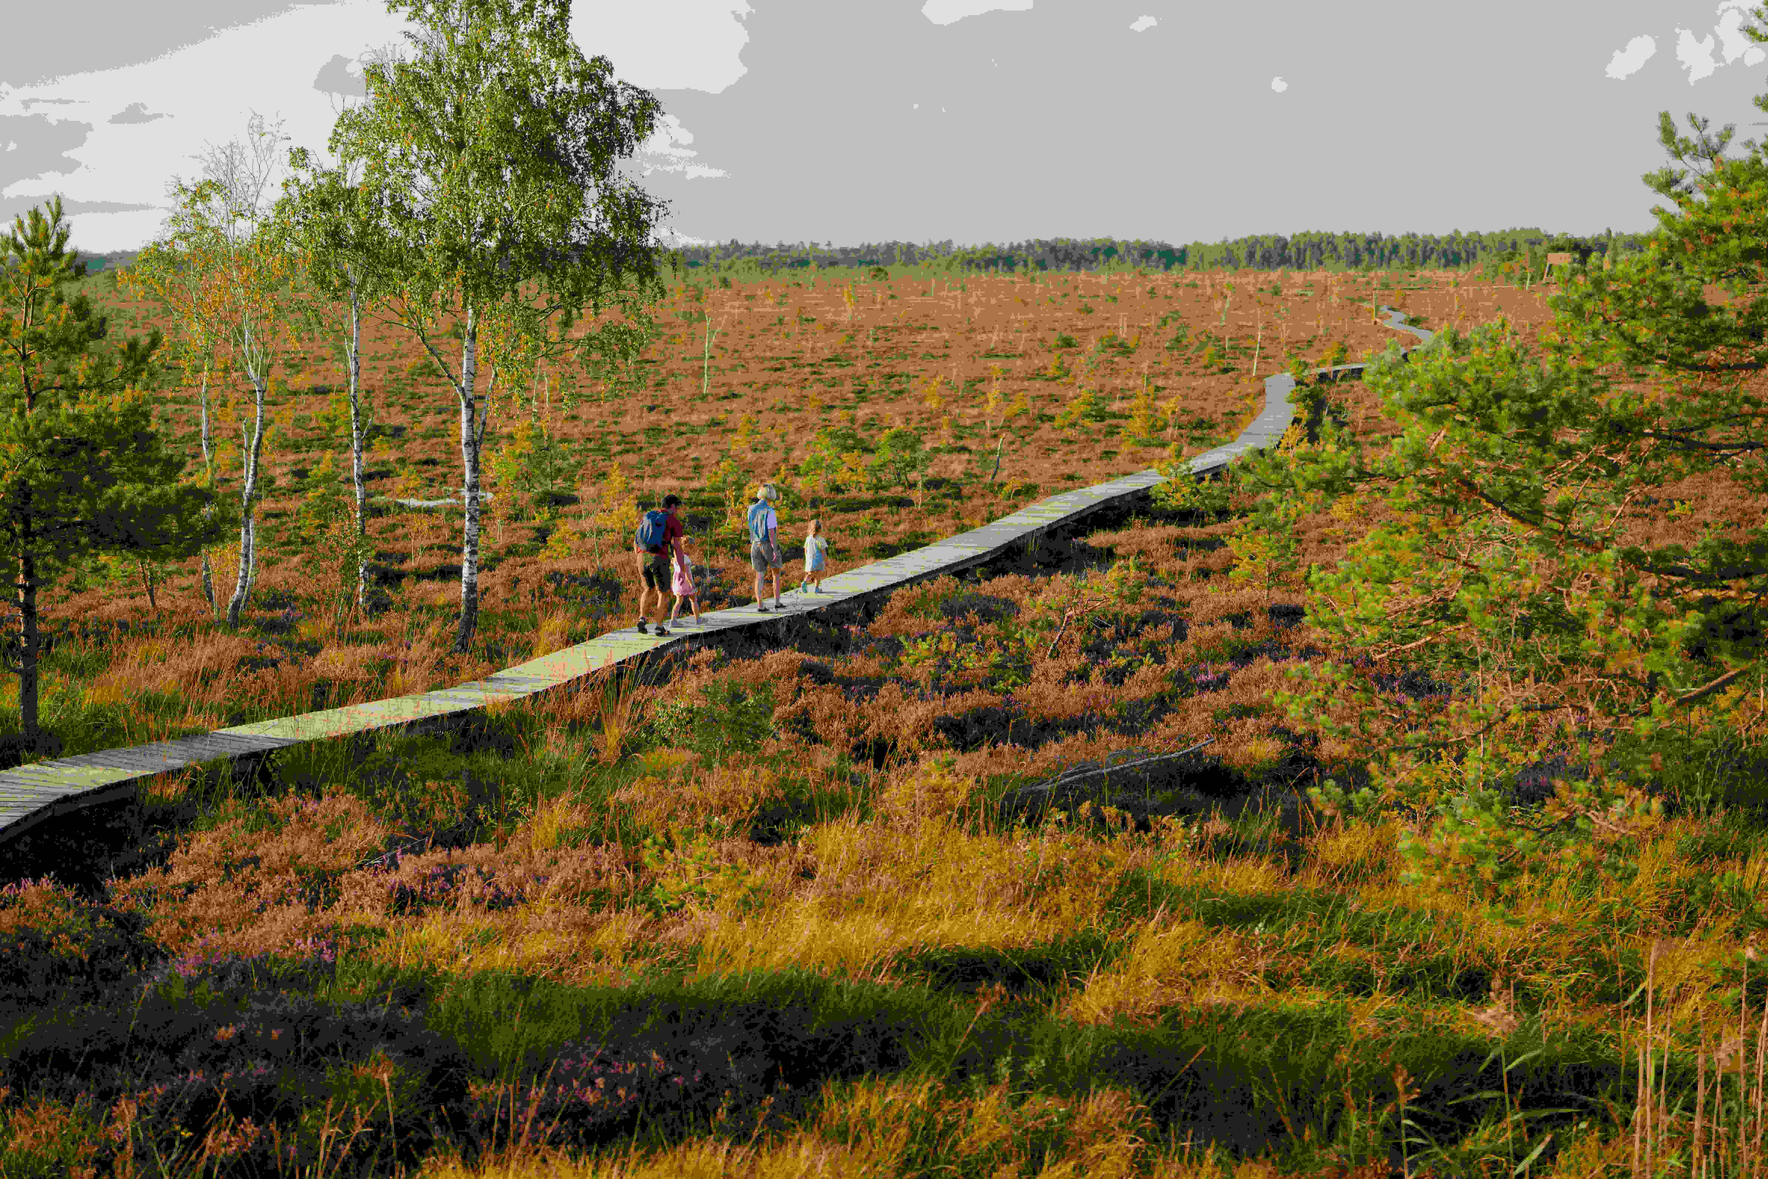


Green Trails Lithuania
Satellite Earth Observation for trails, territories, and tourism that lasts
Discover Lithuania Challenge — UN Tourism × F6S
Notes:
1

Slide 2
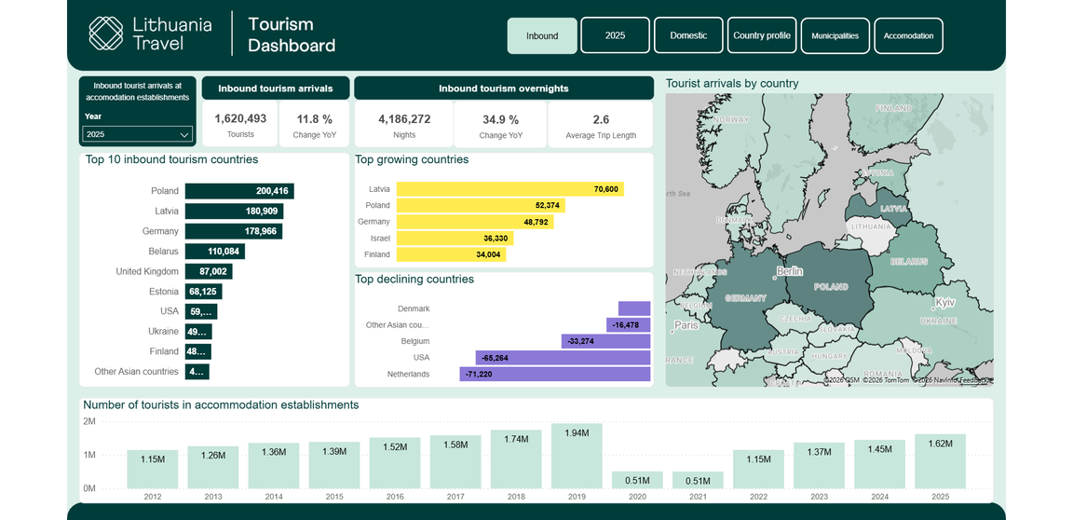
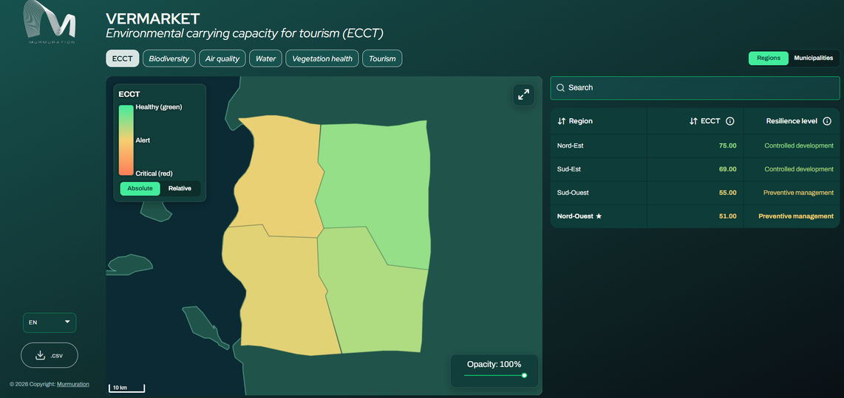
Lithuania’s Green Trails and Tourism
UNESCO heritage, deep forests, historic towns · Underrepresented rural regions · Seasonal fluctuation
Growth, but at what cost?
+
What Lithuania already tracks
The layer we add
Lithuania Travel's own dashboard — arrivals, spend, origin.
Same regions, same seasons — whether the land can take it.
Tourism trends tracked here, but limits can be overlooked for too long. We put them on the same map.

Slide 3
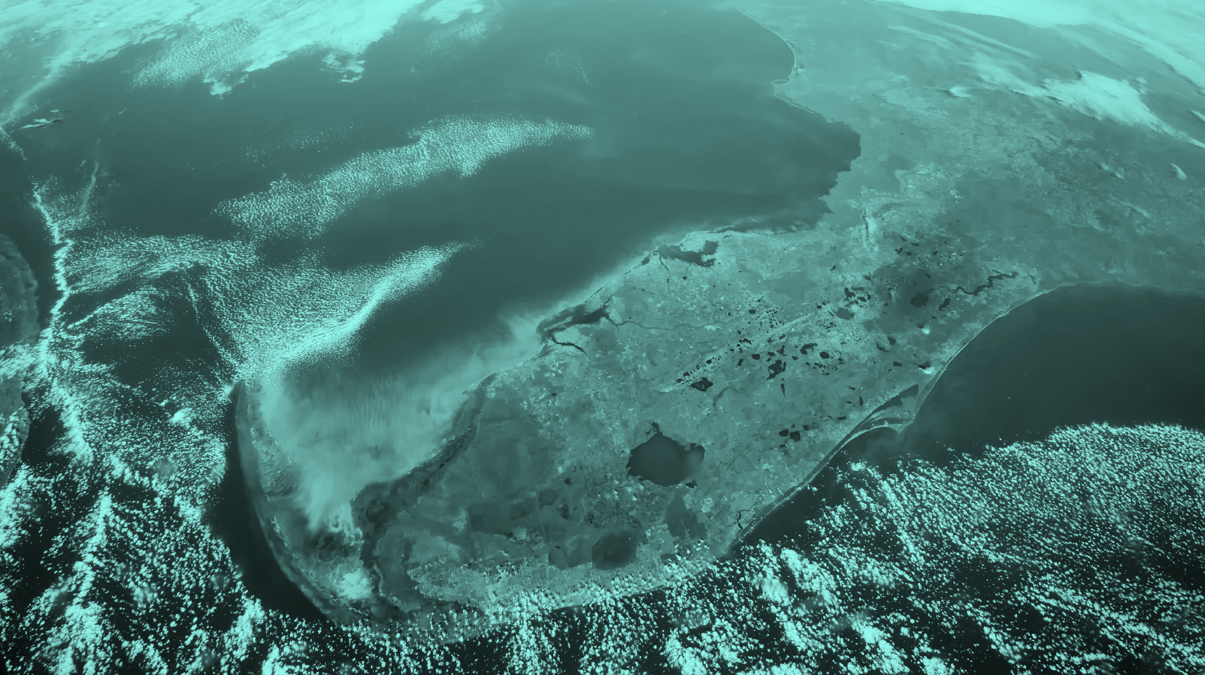
WHO WE ARE
Murmuration
An Earth Observation company turning satellite data into decision-making tools
2019
24
3
100+
Founded
Employees
Cities: Toulouse, Barcelona, Malta
completed projects
We build environmental monitoring tools for tourism destinations, territorial planning bodies, and land managers — turning Earth Observation data (Copernicus, Sentinel-2, ERA5-Land) into indicators that are precise enough to act on, and simple enough for non-technical teams to use.
Our indicators and tools give you the evidence to support your sustainability claims ahead of new EU rules, and align with GSTC standards, the GDS-Index, and Green Destinations certification
03

Slide 4



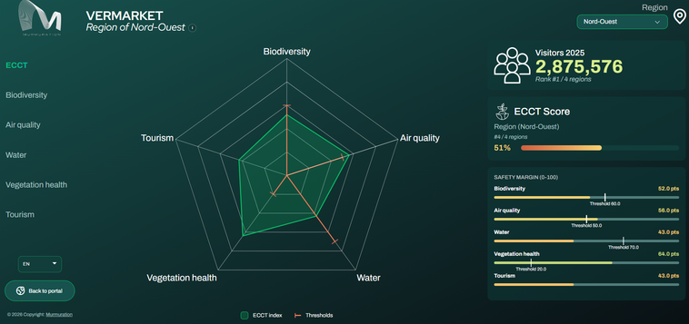
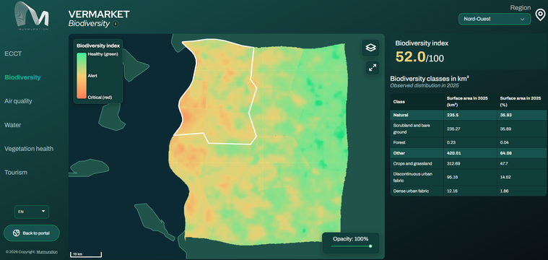
GROWING RURAL TOURISM, DELIBERATELY
ECCT Dashboard - Five indicators and their thresholds
Climate & environmental impact
Threats to natural resources
Proving sustainability claims
Regional overview — resilience level per region. (Demo territory — VERMARKET.)
ENVIRONMENTAL CARRYING CAPACITY FOR TOURISM (ECCT)
Grounded in ecosystem resilience theory (Holling/Scheffer) and planetary boundaries, ECCT measures the thickness of the safety buffer remaining before an ecosystem reaches a critical point of no return on a 100 m resolution grid.
Safety margin, by indicator
Biodiversity condition, mapped

Slide 5
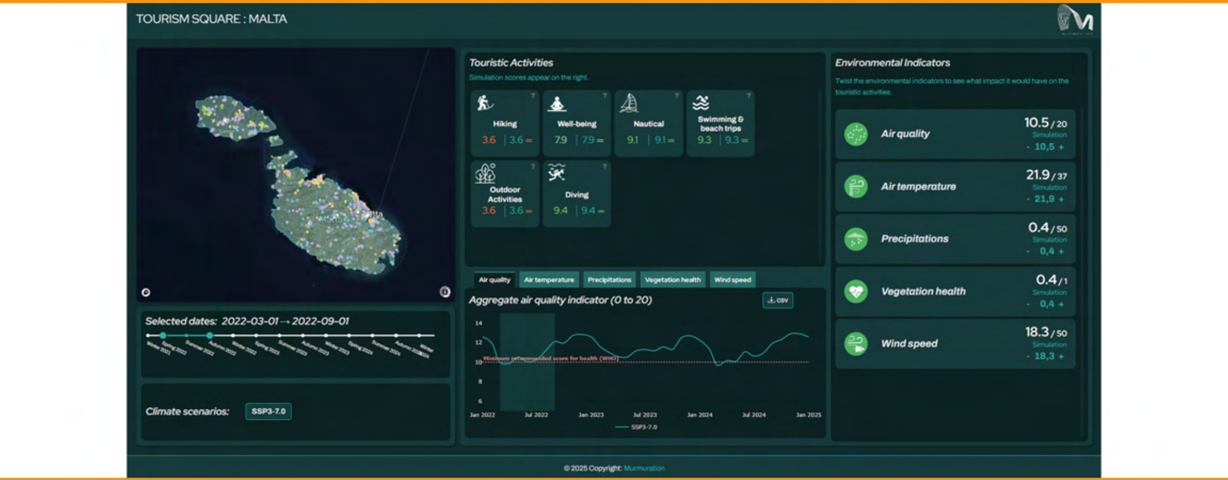
GREEN TRAILS LITHUANIA — CORE FIT
TourismSquare: know before you go
A tourism digital twin: live conditions turned into a practicability score, giving real-time adaptive opportunities for local guides and tour operators.
LAUNCHING NEXT MONTH — MALTA
TourismSquare+
Need × Availability = Vulnerability
Vulnerability score
Very low
Very high
  Ecosystem-dependency mapping for key sites
  Climate scenario stress-testing
Live on Destination Earth and implemented by ECMWF, esa, EUMETSAT
Protects the revenue tied to the same places TourismSquare monitors.
04

Slide 6
PRICING & DEPLOYMENT
What it costs, and how fast
CONFIRMED
CONFIRMED — SCENARIO-BASED
ESTIMATE — PENDING SIGN-OFF
ECCT
TourismSquare
TourismSquare+
€10,000
€4,000/mo
€14–16k
one-time — covers 2 years of data
up to 500 active users/month
2-year engagement, scoped for Malta
  Month 1 — preliminary, open data
  Months 2–3 — operational + user guide
  Scales with usage to €10,000/mo at 10,000+ users
  From a completed tender pricing model
  ENCORE dependency mapping
  Climate scenario stress-testing (IPCC)
€2,500/yr renewal
Usage-based model — confirm this structure fits a Lithuania-wide deployment before quoting.
~€3,000/yr est.
Data updates, ongoing
Not yet confirmed by Cathy or Tarek.
Data sourcing: open data ≈ 1 month · your own data ≈ 2-3 months to clean & integrate · additional data can be purchased where needed.

Slide 7
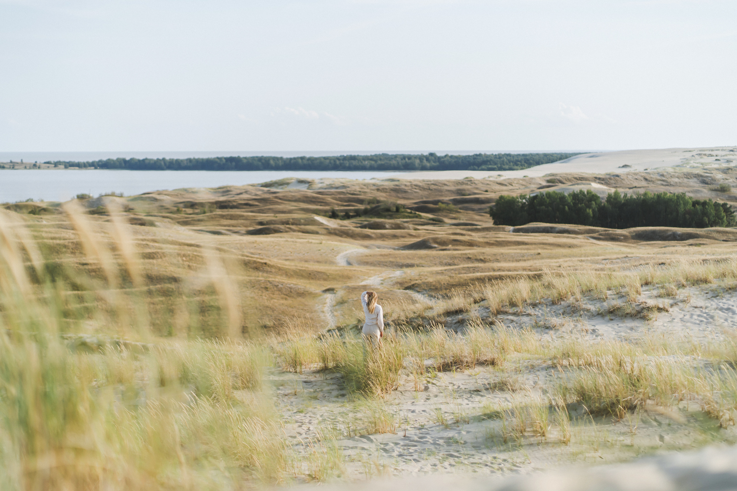


PROVEN WITH REGIONAL DESTINATIONS
Already working with places like yours
Regional tourism authorities across France, Spain, and Portugal — island destinations, coastal DMOs, rural UNESCO-adjacent departments.
One rural department used our data to meet Green Destinations certification criteria. Another regional client is currently using it to meet the GDS Index criteria.
One regional authority used our indicators to build the funding case presented to their governing council. Another is using it to find what transport connections can be improved to increase traffic to certain attractions and accomodations.
🏆 Recognized by UN Tourism — one of 15 winners, 2023 Awake Tourism Challenge

Slide 8
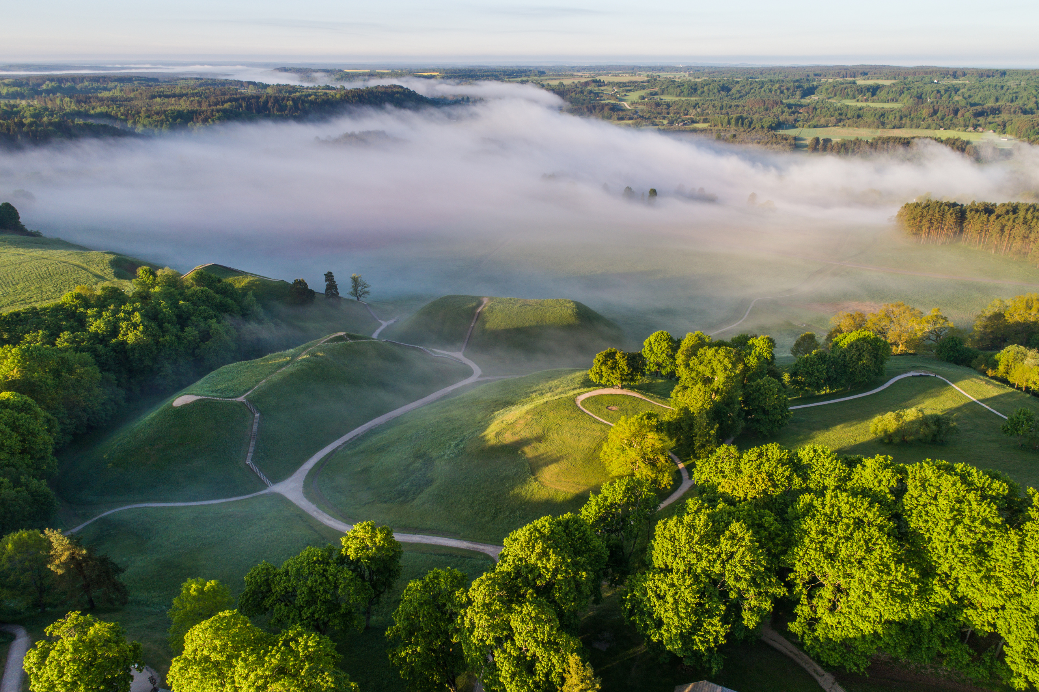

Not a vendor — a seat on the team
As Lithuania’s tourism continues to grow, we’ll be right beside you monitoring what’s changing, helping you protect your heritage sites and trails, and keeping the environment at the center of every growth decision.
Natalie.Gillespie@murmuration-sas.com
murmuration.earth
Murmuration SAS — 1 Rue Giotto, 31520 Ramonville Saint Agne, France

